Slide 1
Efficient Processing of Deep Neural Networks: A Tutorial and survey
Vivian Sze et. al. MIT

Slide 2
The whole paper ~ our course overview
Background on DNN
development history, training vs. inference, applications (Android project), embedded vs. cloud
Overview of DNN
convolutional neural network operations, popular models
DNN development resources
frameworks, pre-trained models, datasets (Android project)
Hardware for DNN processing
Near data processing
Trained network optimizations (sometimes with retraining)
quantization, pruning, compression, filter decomposition ……
Training smaller networks
squeezenet, mobilenet, ……..
Benchmarking metrics for DNN evaluation and comparison

Slide 3
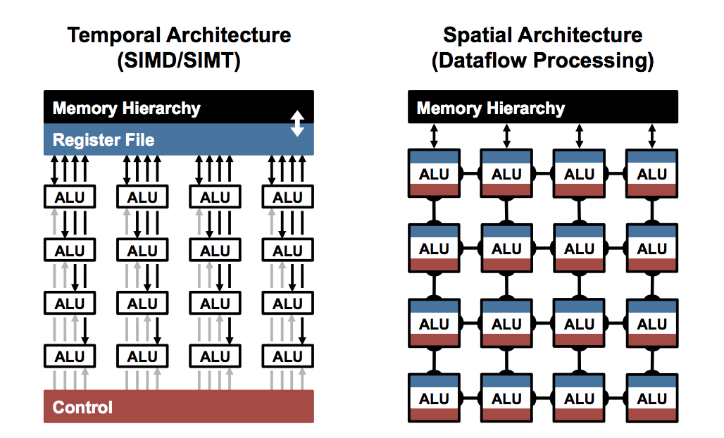
Parallel Compute Paradigms: Temporal vs. Spatial Architectures
Centralized control for large number of ALUs
ALUs only fetch data from memory hierarchy,
no direct communication
Use dataflow processing, ALU (called PE)
with own control logic and local memory,
can pass data from one to another directly

Slide 4
Efficient DNN with temporal architectures
CPU, GPU are general purpose processing elements, not specifically built for DNN
Still lot of efforts to improve efficiency (mostly runtime)
DNN operations expressed as matrix multiplications
less number of matrix multiplications using FFT, Strassen, Winograd and other approaches
hardware optimized linear algebra libraries – BLAS, cuBLAS to do matrix multiplications faster
hardware optimization with instruction prefetching, optimal cache usage, vector instructions, pipelining

Slide 5
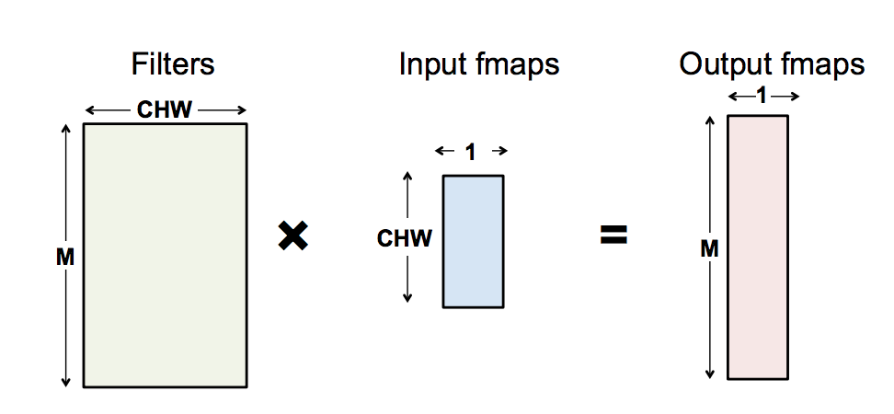
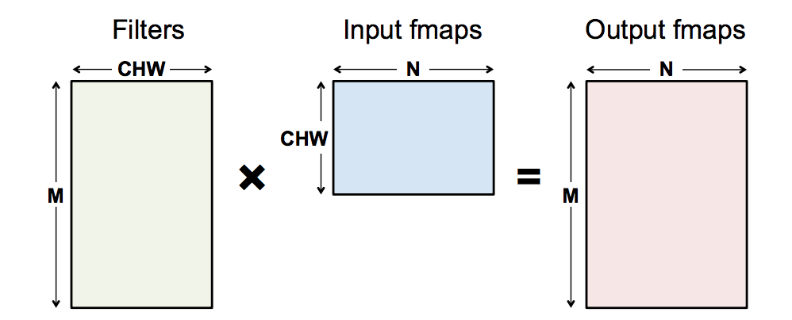
DNN operations as matrix multiplications
FC layer
WxH filter, C channels, M filters, 1 input map
FC layer
WxH filter, C channels, M filters, N input maps

Slide 6
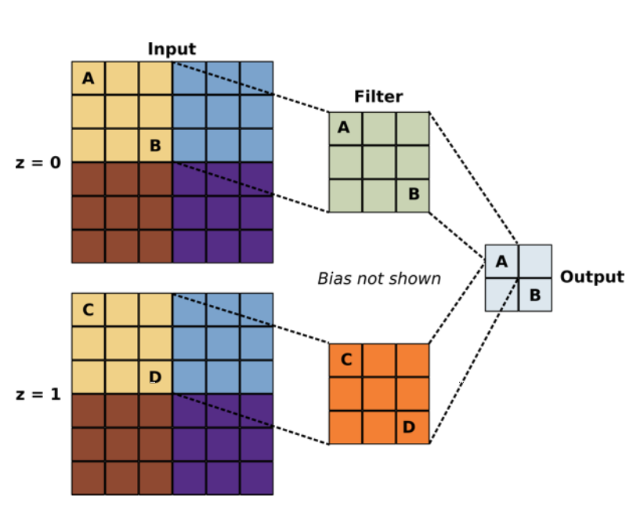
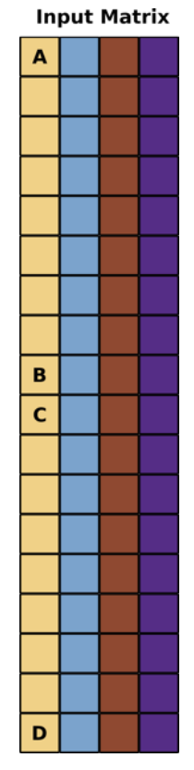
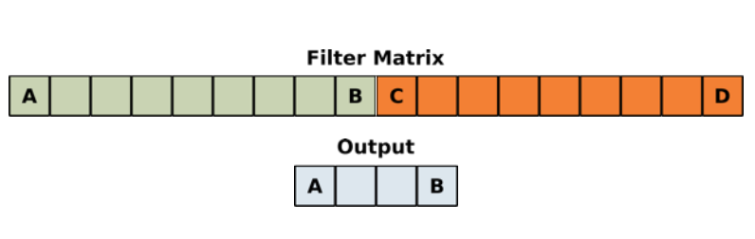
DNN operations as matrix multiplications
Convolution
3x3 filter, stride 3, 2 channels
Equivalent matrix multiplication

Slide 7
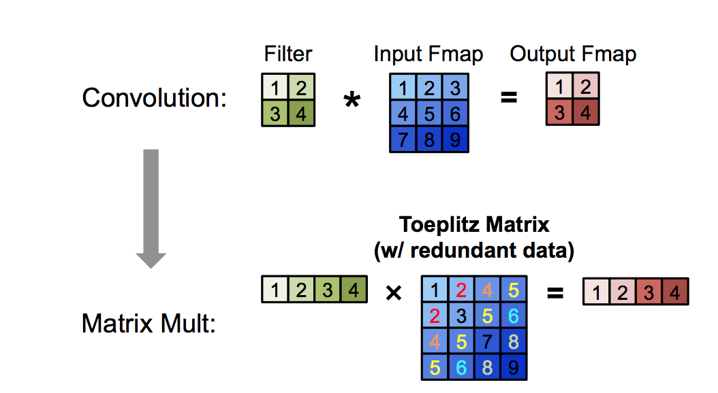
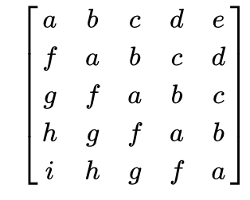
DNN operations as matrix multiplications
Convolution
2x2 filter, stride 1, 1 channel
Toeplitz matrix or diagonal constant matrix,
descending diagonal from left to right is constant

Slide 8
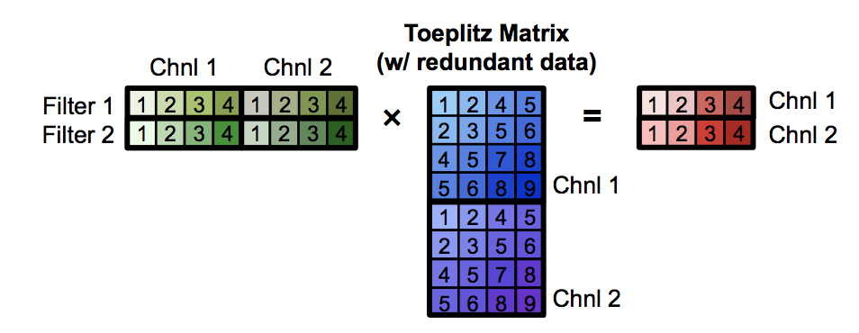
DNN operations as matrix multiplications
Convolution
2x2 filter, two filters, stride 1, 1 channel
Positives
Use optimized matrix multiplication libraries available for CPU/GPU architectures
Negatives
Redundant data -> inefficiency in storage or complex memory access pattern

Slide 9
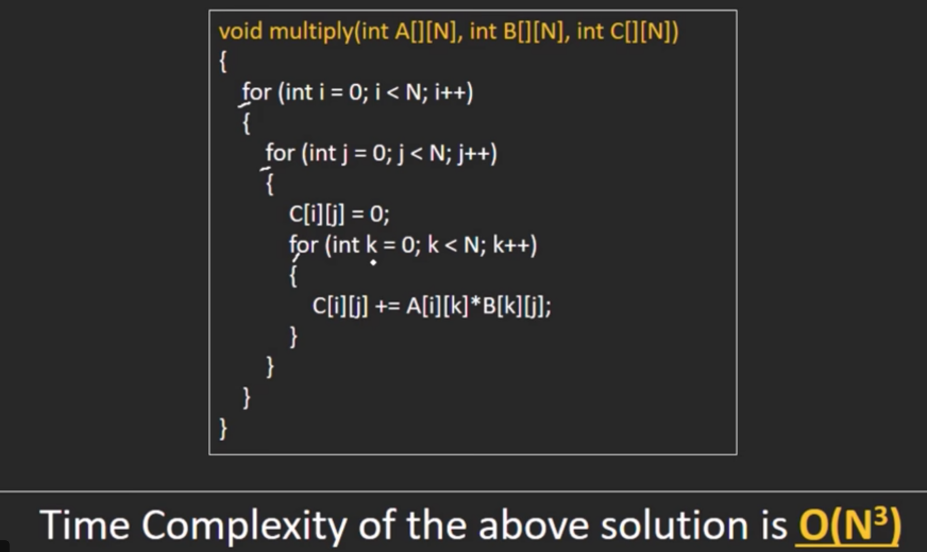
Less number of matrix multiplications

Slide 10
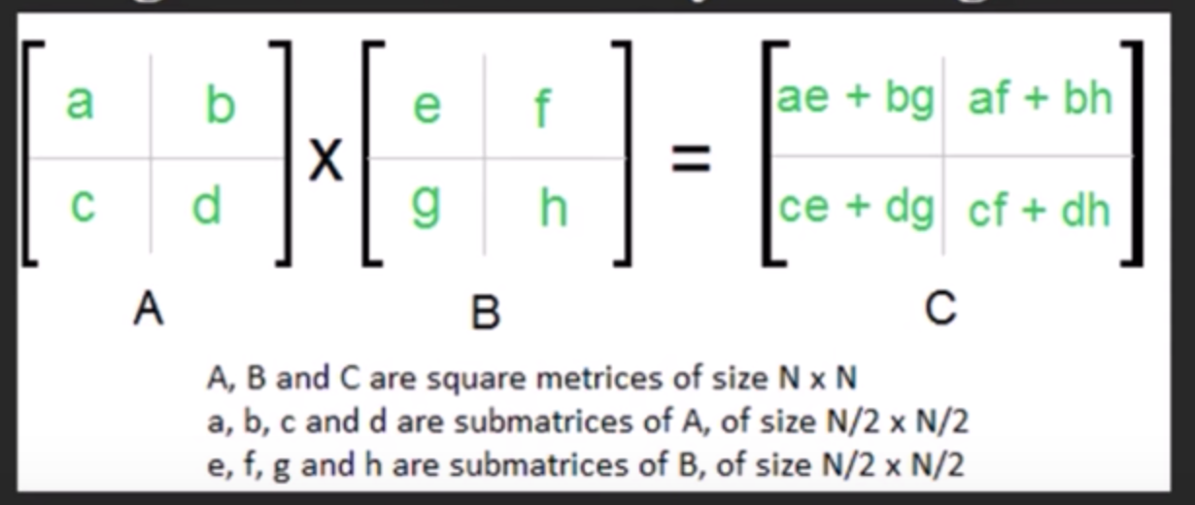
Less number of matrix multiplications

Slide 11
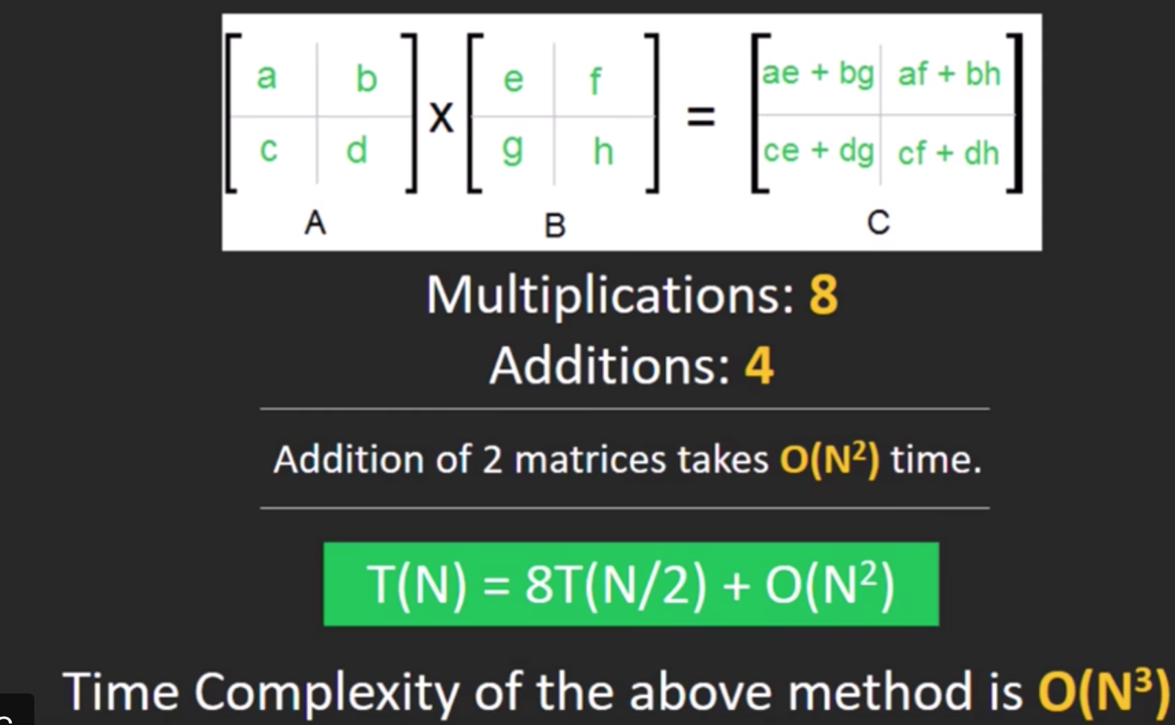
Less number of matrix multiplications

Slide 12
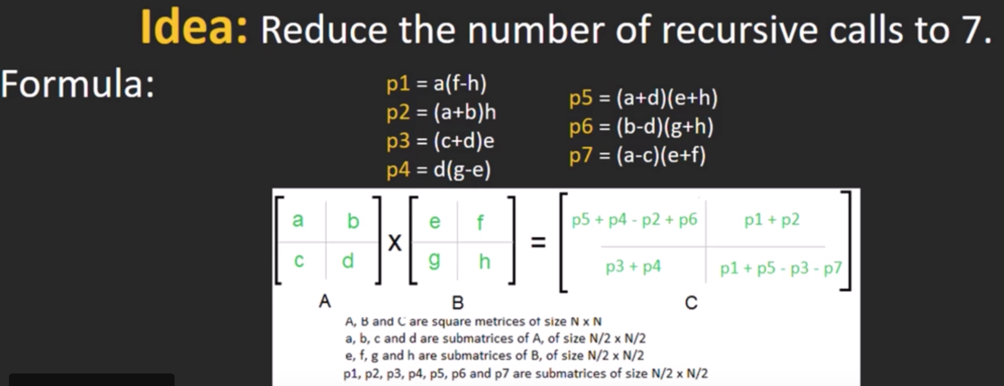
Less number of matrix multiplications

Slide 13
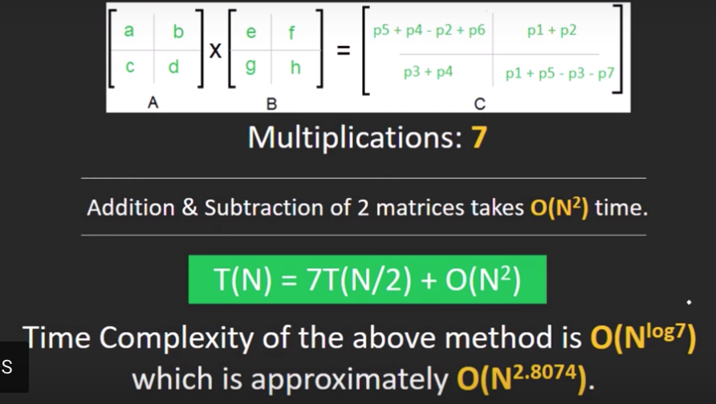
Less number of matrix multiplications

Slide 14
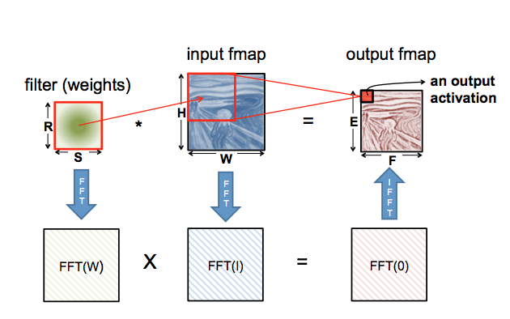
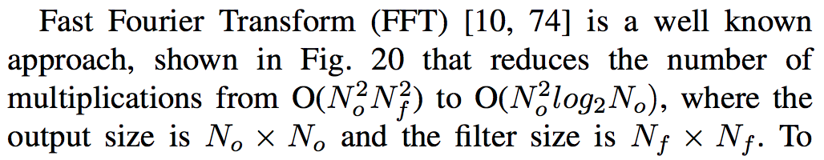
Less number of matrix multiplications

Slide 15
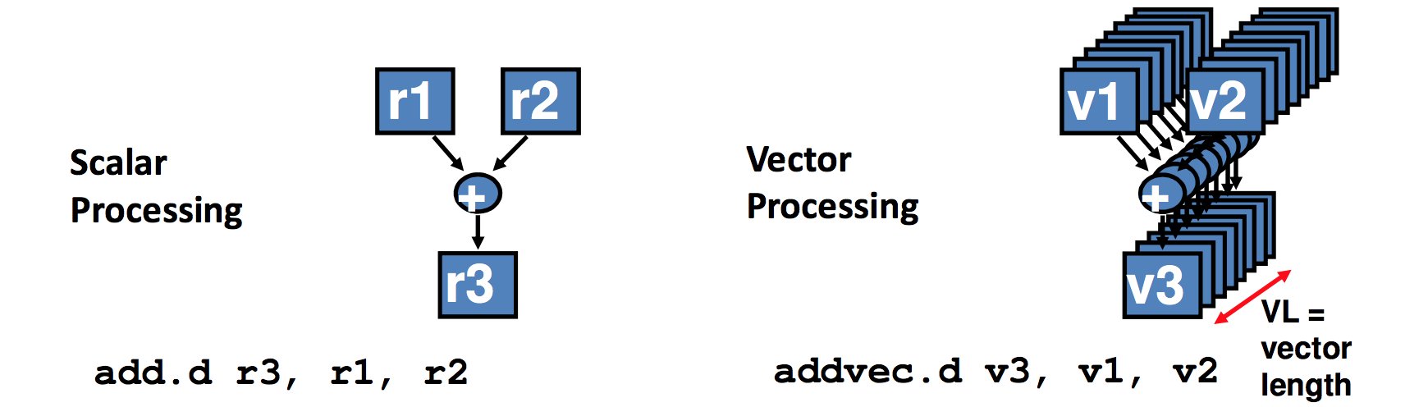
Hardware optimized (for latency) matrix multiplications
Instruction prefetching, pipelining
Parallelization
SIMD
SIMT
Exploit memory hierarchy with caches
http://web.cs.ucdavis.edu/~bai/ECS231/optmatmul.pdf
https://people.eecs.berkeley.edu/~demmel/cs267_Spr99/Lectures/Lect_02_1999b.pdf

Slide 16
Parallel Compute Paradigms: Temporal vs. Spatial Architectures
Centralized control for large number of ALUs
ALUs only fetch data from memory hierarchy,
no direct communication
Use dataflow processing, ALU (called PE)
with own control logic and local memory,
can pass data from one to another directly

Slide 17
Efficient DNN with spatial architectures
Specialized architectures for DNN
Doesn’t piggyback on hardware optimized libraries after mapping DNN operations to generic algebraic operations like matrix multiplications
DNN operations scheduled on spatial architectures to exploit
parallelism among independent operations
sparsification of weight matrices (with pruning) and sparsification of activations (with RELU) for less computations
memory hierarchy across PE registers, PE interconnects, global buffer and DRAM for energy efficient dataflows
…………
EIE (ISCA’16), SCNN (ISCA’17), Eyeriss (ISCA’16) are examples

Slide 18
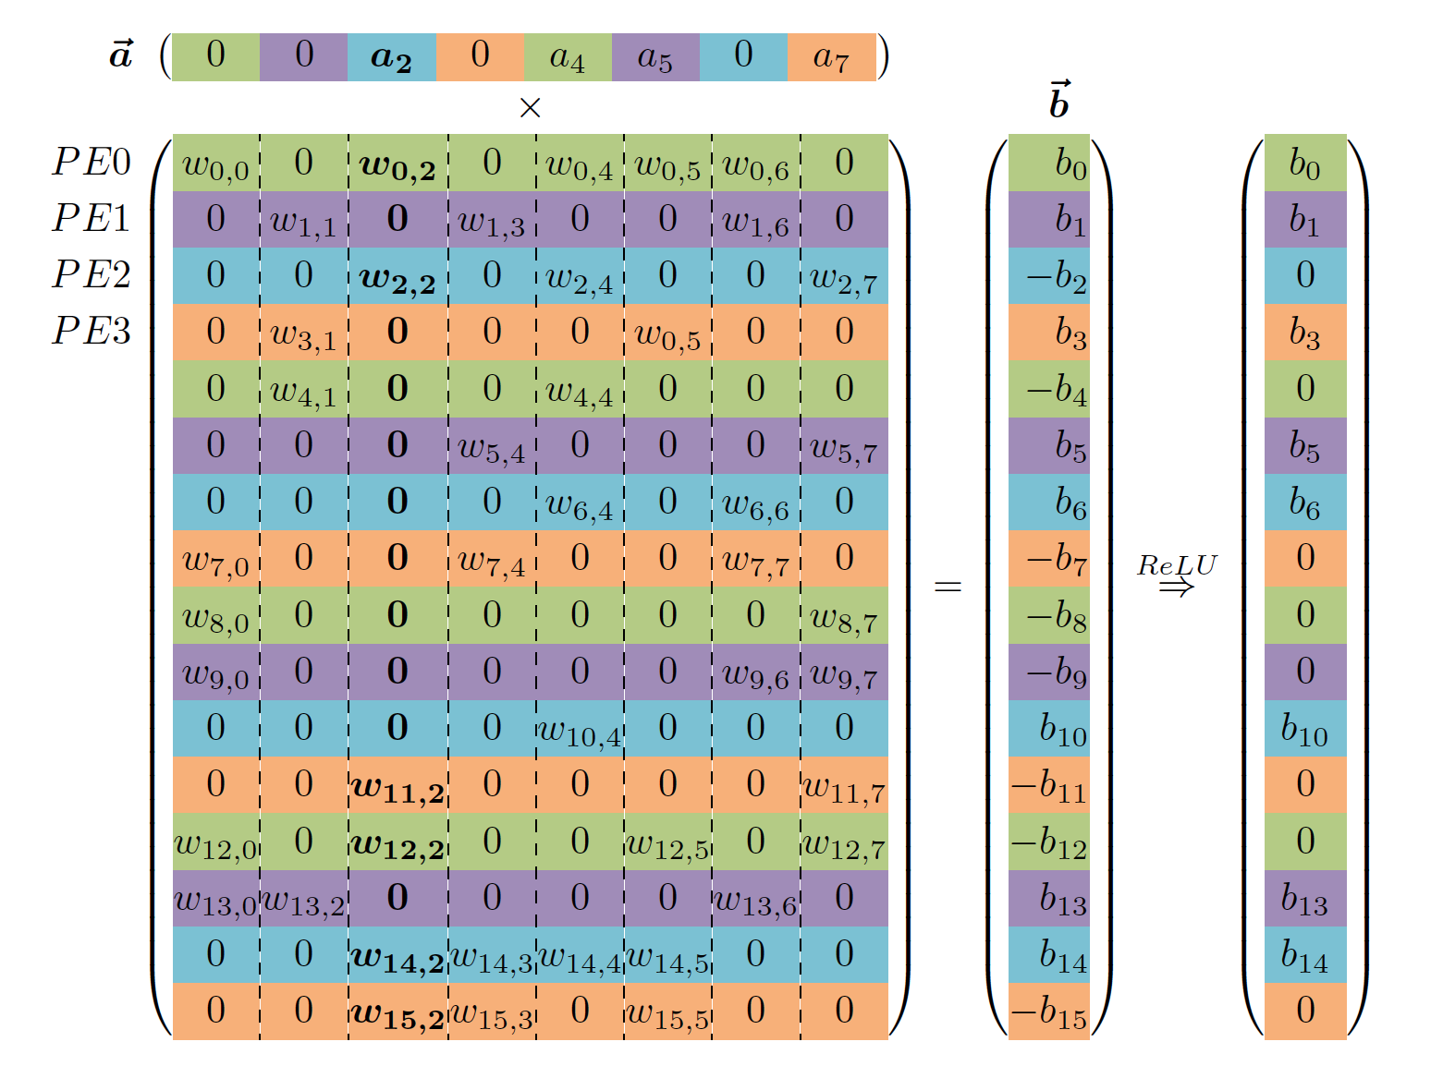
Parallelism among independent operations
EIE: For FC layers, each PE gets a portion of the activation and weights

Slide 19
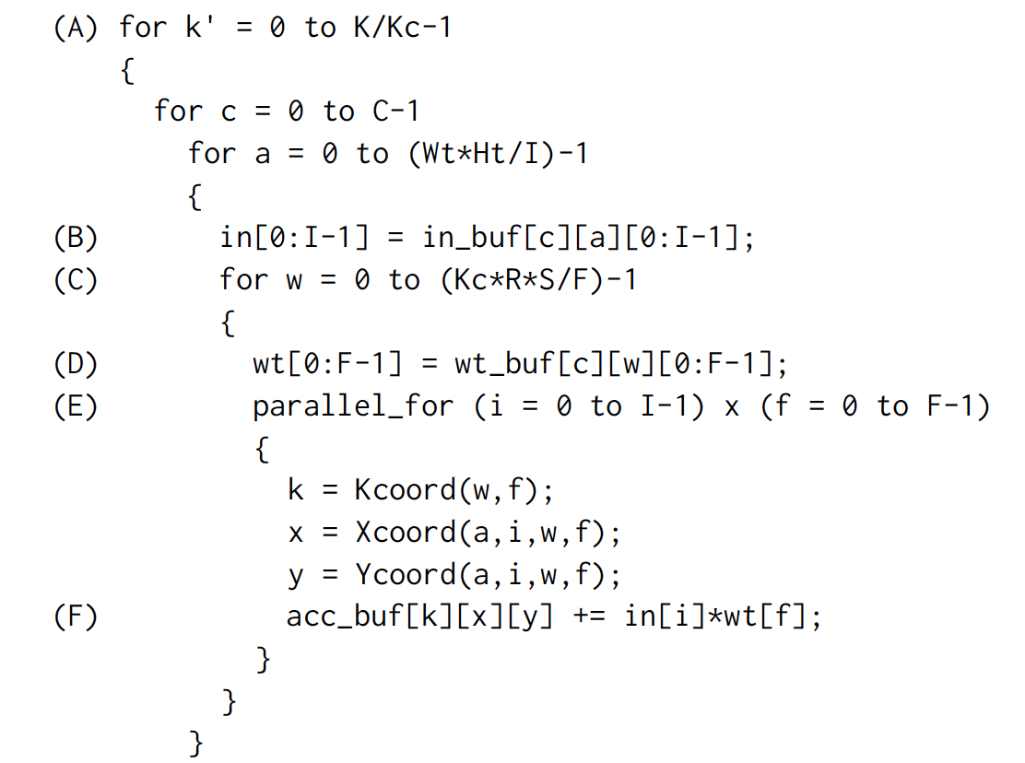
Parallelism among independent operations
Inter PE parallelism
each PE gets Wt*Ht
portion of activations
Intra PE parallelism
each multiplier in a PE
gets I activations and F
weights
Output coordinate
SCNN: For Conv layers, each PE and each PE multiplier
get a portion of the activation and weights

Slide 20
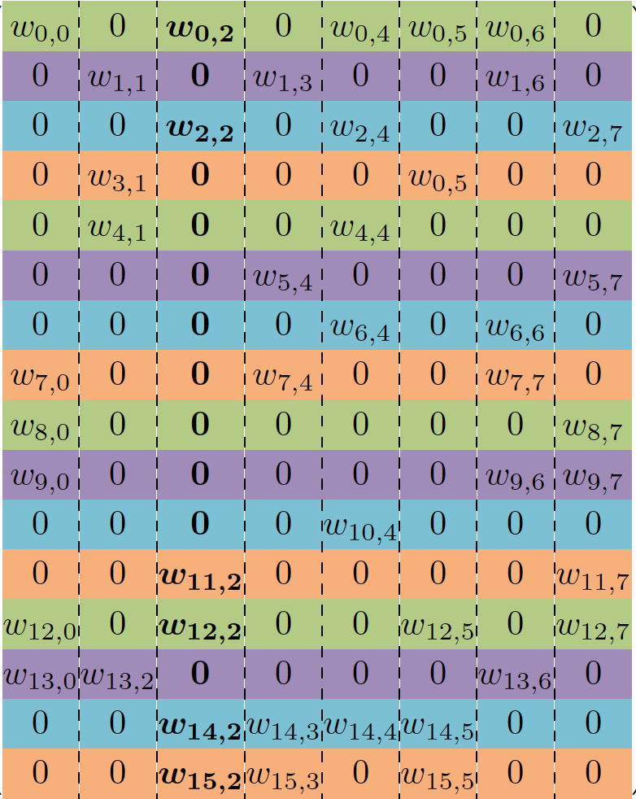
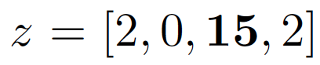
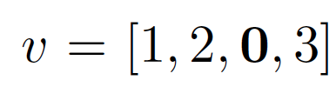
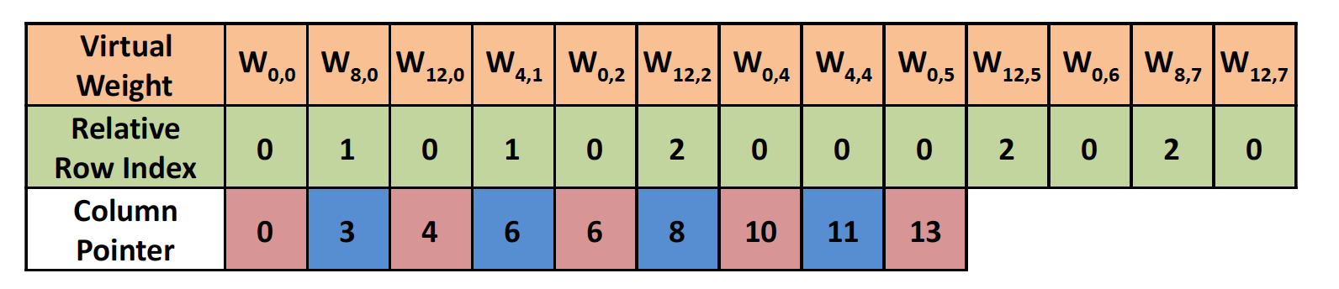
Sparsity and compression
v
x
p
EIE and SCNN: non-zero weights stored with additional indeces

Slide 21
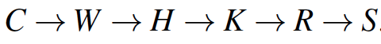
Memory hierarchy
N = 1 for inference
Reuse activations: Input Stationary IS
Reuse filters
SCNN: Planar Tiled-Input Stationary-Cartesian Product-Sparse dataflow

Slide 22
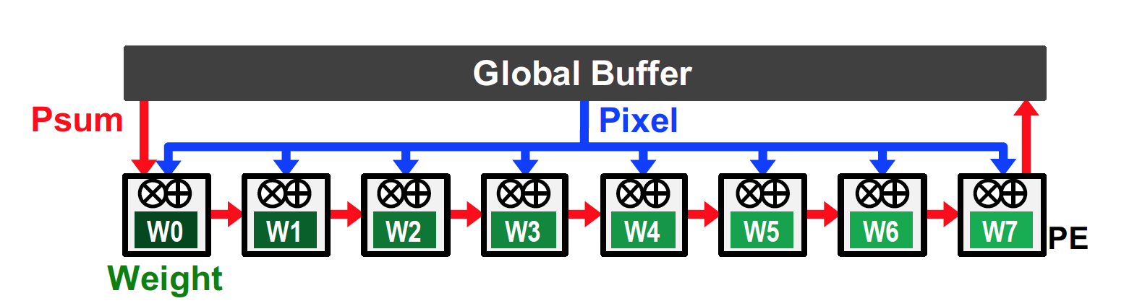
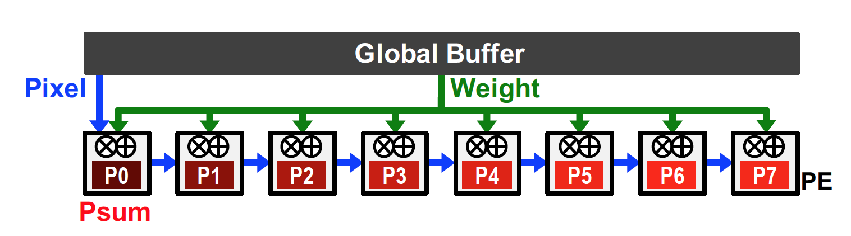
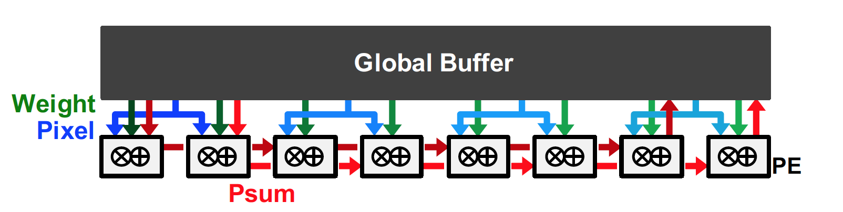
Memory hierarchy
Eyeriss related work: weight and output stationary, no local reuse

Slide 23
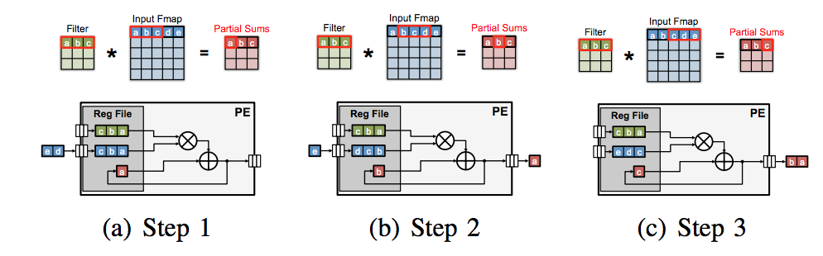
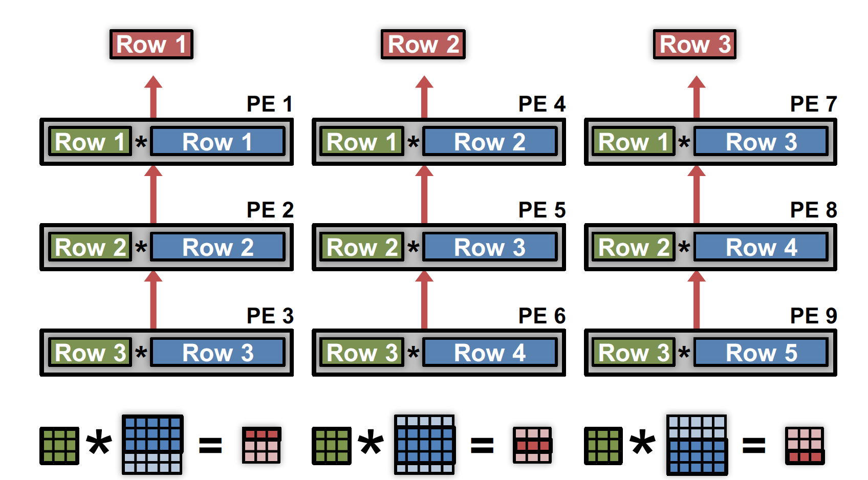
Memory hierarchy
Eyeriss: row stationary in 1D and 2D convolutions

Slide 24
Core ideas’ similarities between temporal and spatial architectures
DNN operations expressed as matrix multiplications
less number of matrix multiplications using FFT, Strassen, Winograd and other approaches (reduced operations with sparsity in spatial)
hardware optimized linear algebra libraries – BLAS, cuBLAS to do matrix multiplications faster
hardware optimization with instruction prefetching, optimal cache usage (memory hierarchy in spatial), vector instructions, pipelining (parallelization among independent operations in spatial)

Slide 25
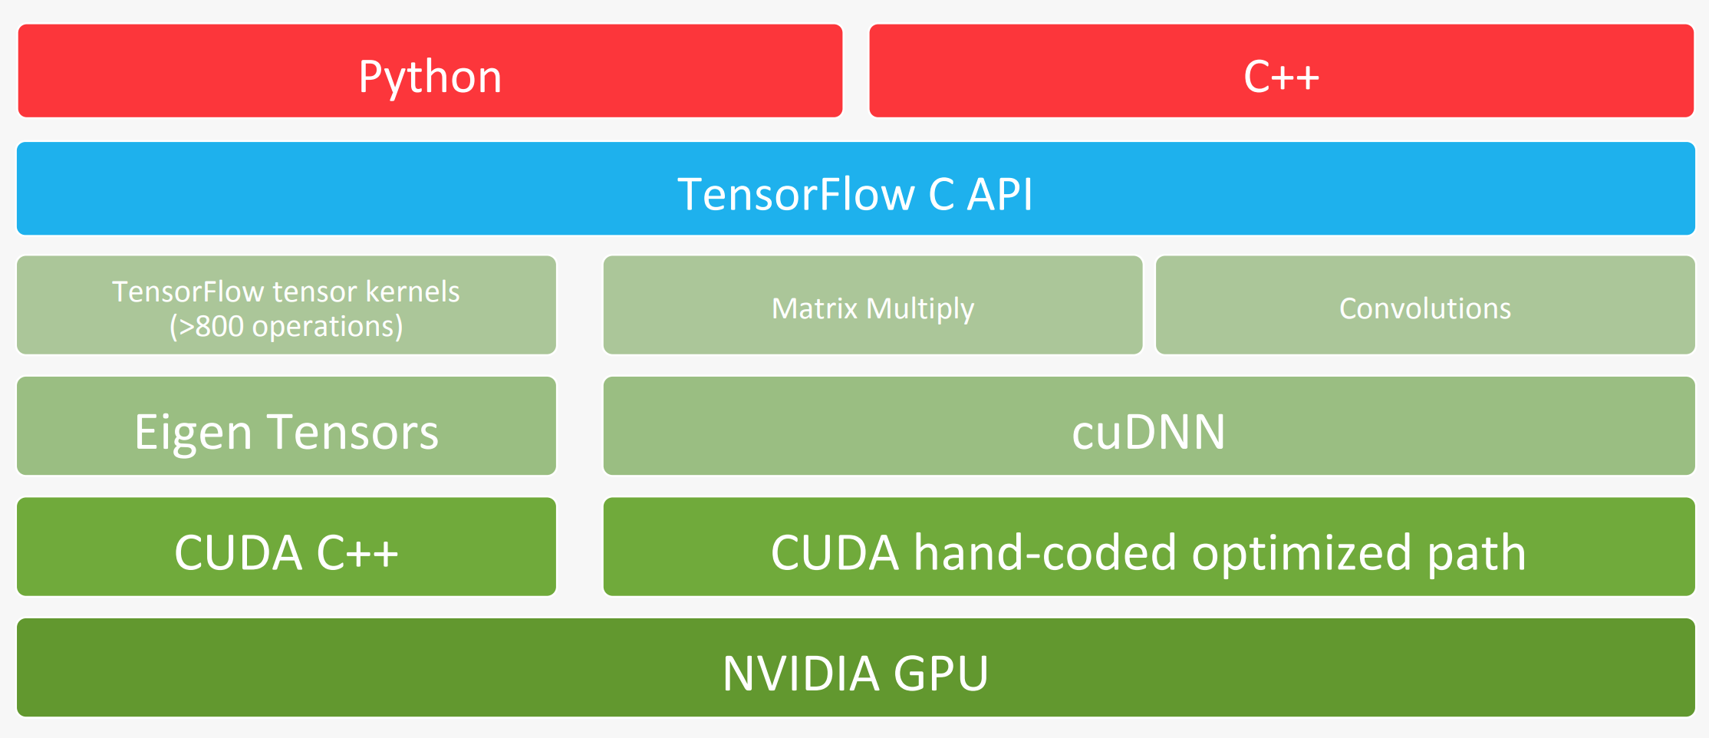
Software design for temporal architectures
Higher layers are hardware architecture agnostic – provided by ML researchers
Lower layers are hardware architecture aware – provided by platform vendors

Slide 26
How to use a new accelerator
http://nvdla.org/
List of DNN chips
https://medium.com/@shan.tang.g/a-list-of-chip-ip-for-deep-learning-48d05f1759ae

Slide 27
The whole paper ~ our course overview
Background on DNN
development history, training vs. inference, applications (Android project), embedded vs. cloud
Overview of DNN
convolutional neural network operations, popular models
DNN development resources
frameworks, pre-trained models, datasets (Android project)
Hardware for DNN processing
Near data processing
Trained network optimizations (sometimes with retraining)
quantization, pruning, compression, filter decomposition ……
Training smaller networks
squeezenet, mobilenet, ……..
Benchmarking metrics for DNN evaluation and comparison

Slide 28
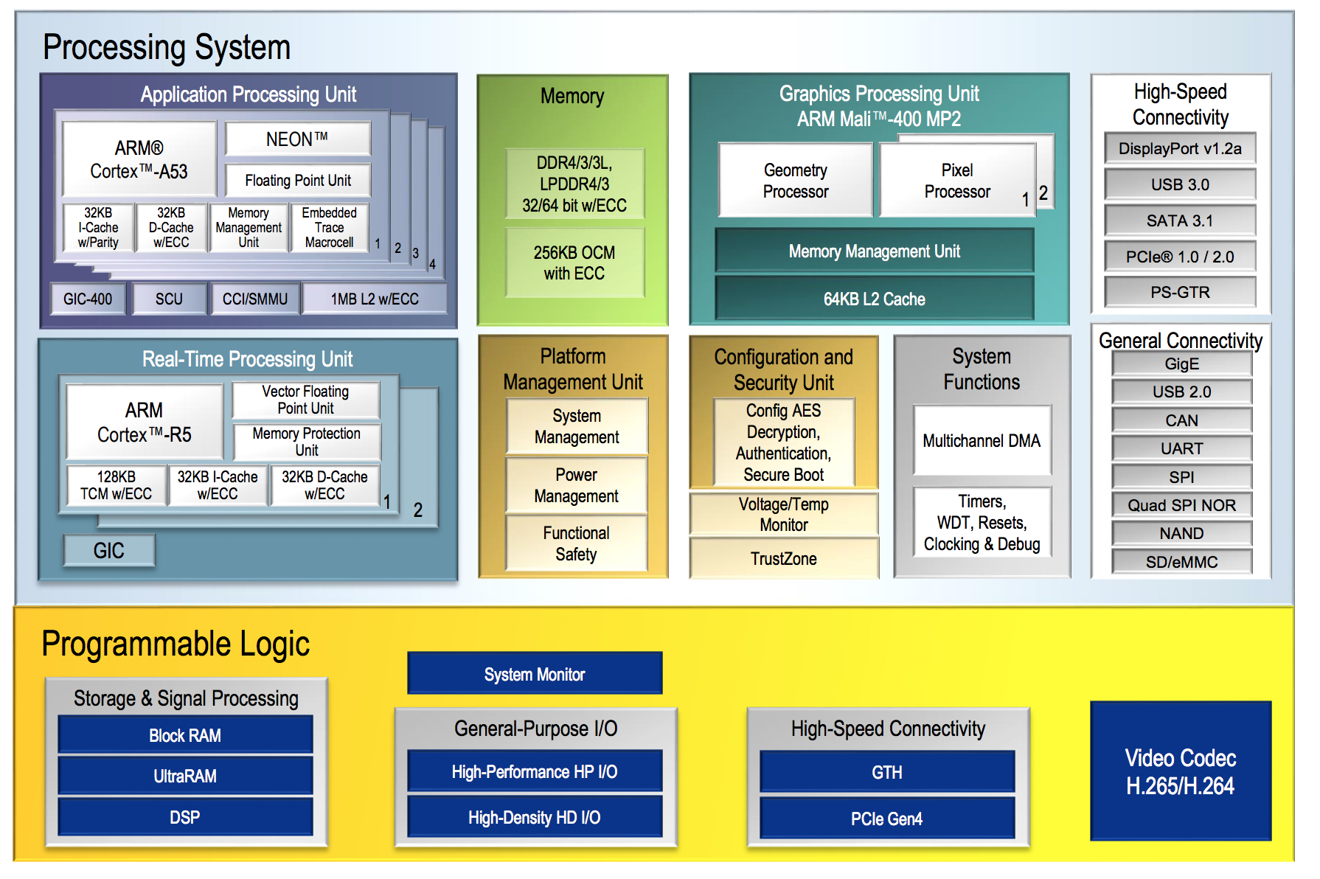
Typical available embedded platform

Slide 29
Friday class
For a given hardware platform (unlike past classes on computer architecture) and a given DNN (unlike post midsem-break classes), what optimizations can be done to improve latency and energy?

